Slide 1
Knowledge Hub
AbtK In SharePoint Wirframe and Process Flow

Slide 2
Purpose of This Document
Purpose- to provide a visual example of the pages in the knowledge hub with a focus on project information as an example of navigation
Audience
Anyone who requires signing off
Contact Puja, Sarah, Jose for questions

Slide 3
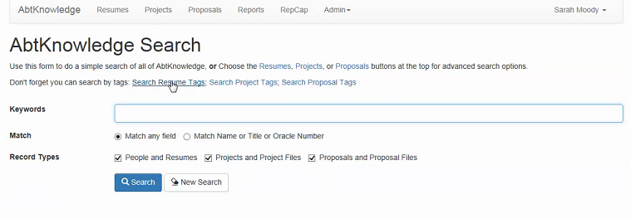

Knowledge Hub Landing Page
About The Knowledge Hub
SEARCH
Knowledge Hub Search
RepCap and repcap files
Boilerplates
Promoted Links for navigation
Project & Project Files
Proposal & Proposal Files
Repcap & Repcap Files
BoilerPlates
Key Contacts
Site Contacts
Technical Training
Other Centralized
FAQs and Quick Reference Guides
Notes:
User clicks on the Knowledge Hub link and is brought to the above landing page made up of the following:
Summary about the knowledge hub- brief description on what the hub is
Knowledge Hub Search- Key word Search box that, with check boxes to specific record types in the knowledge hub (projects, proposals, repcap, boilerplates, and anything else that should be centralized. Search should be for the entire site collection
Maintained by KM, promoted links hyperlinking to the specific area a user wants to navigate- IE directly to project and project files etc
Key Contacts, Site Contacts, FAQs and “how to” reference guides
Front page:
User Comment: ABTK-Refresh Simple search is great (tag, resumes, projects, proposals, oracle number, boilerplate, RepCap etc .. )
User Comment: Users normally want to go to an specific project, not browsing around.
Questions:
Is this the best place for people and resumes? (maybe better at ppl finder).
Deepa:
Record Types and Matches will be displayed as drop down (Extreme right pic containing Everything, People etc.)
Based on the selection user will be taken to Search page where he will perform search and will be displayed search results relating to the selected category.

Slide 4
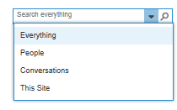
Project and Project Files
Proposal and Proposal Files
Reputational Capital Database
Boilerplates

Slide 5
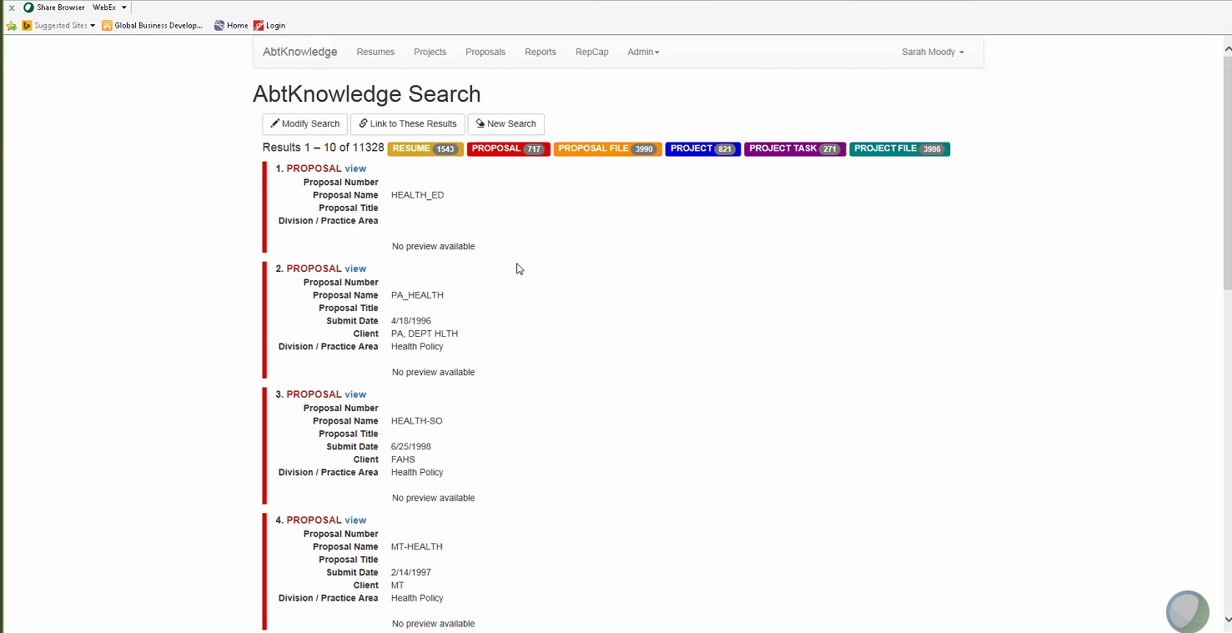
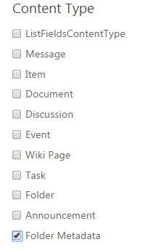
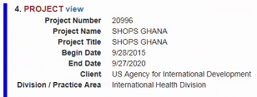
Conducting a Search
Knowledge Hub Search
Ghana
RepCap and repcap files
Boilerplates
Search Results “Ghana”
Knowledge Hub Search Results
Color coded result filters
Color coded result
Notes:
Deepa:
The color coding of results won’t be possible, and result filter will be displayed as the extreme left hand side picture (Here the Content Type is taken as example).

Slide 6
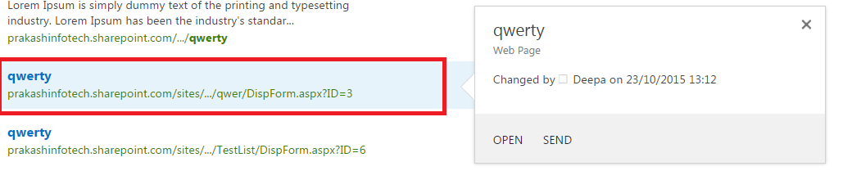
Project Summary
Knowledge Hub Search
Magnified project summary. User should be able to click from summary to to view details
Boilerplates
Notes:
User Comment: Users should be able to look at the project description (hoover screen is an option).
Separate things using headers.
Header will expand or collapse to display the results or hide them.
Ability to choose the amount of results to be displayed.
Ability to sort results by client, division, due date, begin date, etc…
Deepa:
At bottom of this slide I have displayed how result and it’s preview is getting displayed. So, for customizing as desired by user I have to do some research.

Slide 7
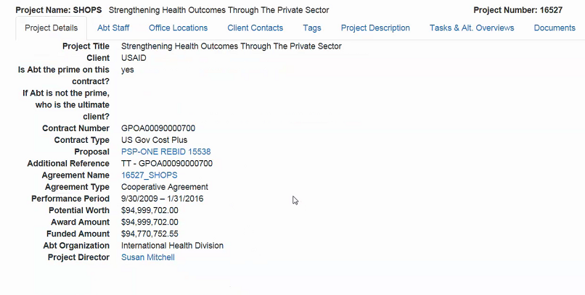
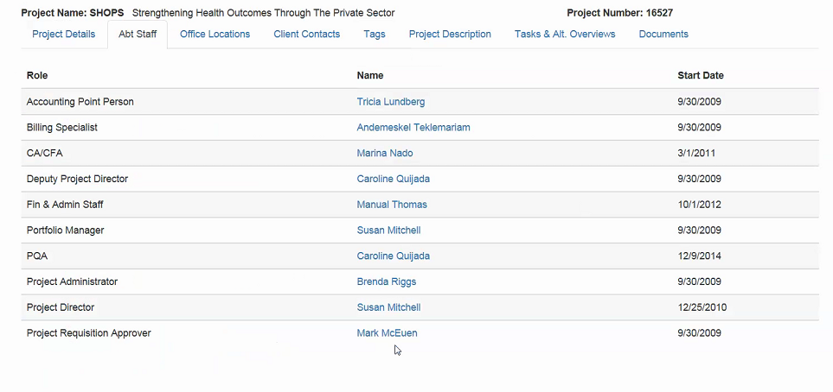
Project Details From Oracle
Abt Staff Details (from oracle)
Include Abt Staff
Notes:
Track the people who charged hours to the project.
Questions:
Who to deal with the contractors?
Do we have a way to know the name/role of a person when charges hours to the project?
How do we identify who is key?
Automate -> pull the people from the oracle feed and then add a role.
Note: We already have the ability to pull an oracle feed, that’s how AbtKnowledge works today.

Slide 8
Project Details (from AbtK that users can add and edit in the future (within sharepoint)
From Oracle Feed
Included Abt Staff from oracle
Added to record manually (currently in abt K)
Project Description (once migrated, users add/edit)
Project Tags (from term store)
Project Documents (once migrated, users add/edit)
Notes:
Deepa: looks doable.

Slide 9
On the consolidated project page view (slide above)
Project Details From Oracle (quick edit for terms and good reference. Maintain read only for fields coming from oracle) + Terms (modify) | Project Descriptions (ability to quick edit, add and modify) Flat File
 | Project Documents (ability to Upload/add/modify)
 | Project Team (Read only)
The description title takes the user to the description details
Description Title | Project Overview | Description Type
XXXX |  | Primary
YYYY |  | Alternate
The document property takes the user to the document field details where they can see tags
Document Property | Document Name | Date (TBD)
Detail | This is a name | ##/##/####
Detail | Deepa Sarah | ##/##/####
The document name opens the document
Full Name | Project Role
Puja Bhullar | Super hero
Sarah Moody | Avatar
Notes:
Deepa: looks doable.

Slide 10
On the consolidated project page view (slide above)
The project page that opens is a two column template
Project Fields: Project fields from oracle/ERP will be in the left column. If the information in the field is long, the information should wrap to the next line
When a user clicks on quick edit in column 1- they can edit fields that are editable
Terms applied to the project (editable metadata fields) should be pushed to any description or document related to this project
Description Web part: When a user adds a description from this page, the description web part should autopopulte the project name/project ID to align the description to the project
User should not have to assign project/project id to the description
Document Web Part: This rule applies to the document webpart as well

Slide 11
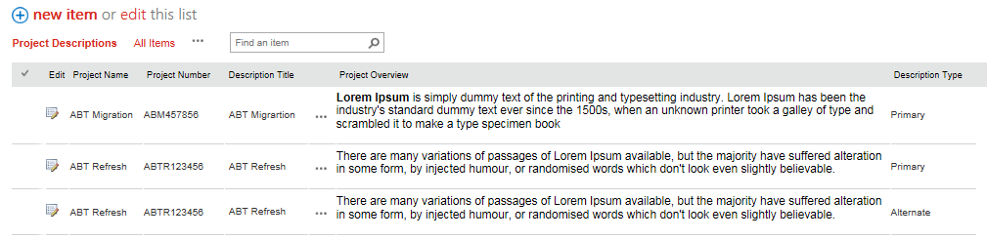
Project Description List
Project names should take the user back to the consolidated project page view

Slide 12
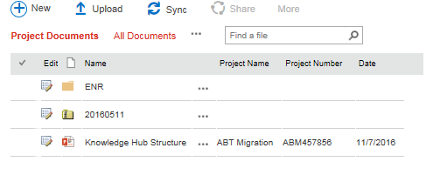
Project Document List
Project names should take the user back to the consolidated project page view

Slide 13
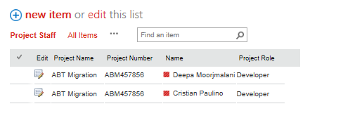
Project Staff List
Project names should take the user back to the consolidated project page view

Slide 14
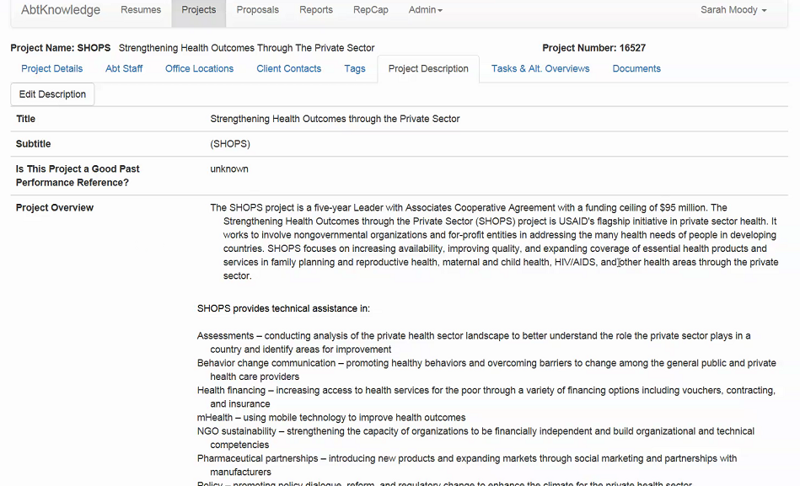
Project Description Part1
Notes:
Deepa: looks doable.

Slide 15
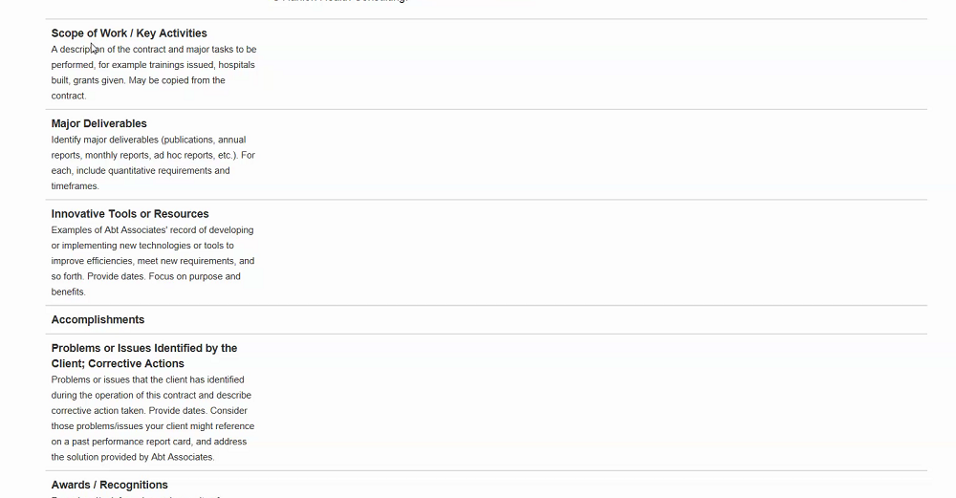
Project Description Part2
Notes:
Project description is made up of multiple fields.
Note:
We want to display all the possible fields when clicking the “edit button”.
Deepa: looks doable, we’ll have a separate list to hold project desciption.

Slide 16
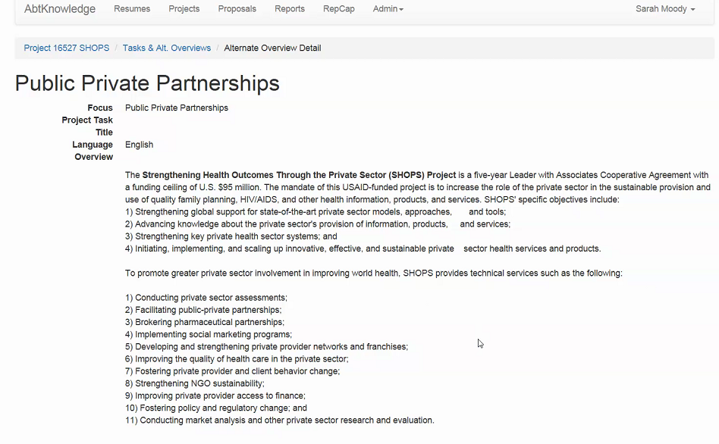
ENR Task alt overview
Note- ENR Tasks will be treated as projects and their project description can be found in the alternative overview
Notes:
Nice to have: “ENR tasks” should be called projects as well to avoid confusion to the users.
Deepa: looks doable. (This is still open)

Slide 17
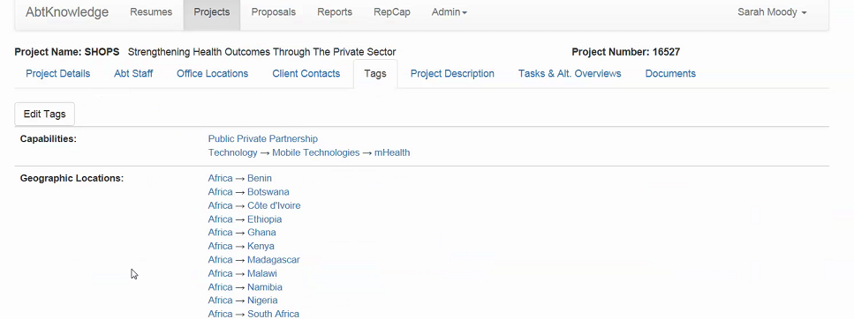
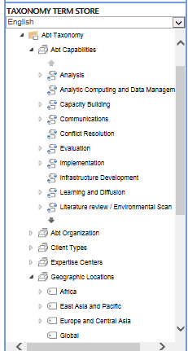
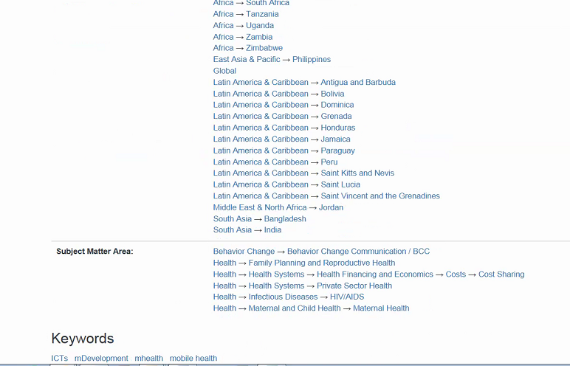
Project Tags
In current Abt K
In SharePoint Term Store
Notes:
Deepa:
There are going to multiple tags to be associated with projects/document etc. and these multiple tags will be stored across various columns in the list. Looks doable.

Slide 18
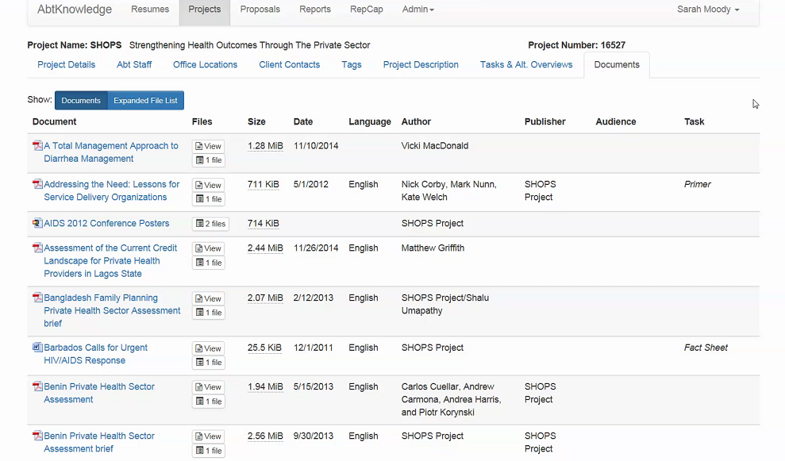
Project Documents
Will be replaced by a sharepoint document library
View in Abt K
Notes:
Deepa: looks doable.

Slide 19
More Search Details

Slide 20
Result Filters
Boilerplates
Training
Project Site
Proposal Site
Other
Result filters should include all central libraries created in the Knowledge hub
Out of the box sorting available
Date of project and proposal –
Relevance-
Default: newest to oldest
Other – most viewed
Last updated
Client
Type
Notes:
Search Results:
Results filters should include filters for all key areas of the site collection, including central libraries and list, project and proposal spaces
Result Total of tags is a nice to have if available out of the box
Deepa
Custom sorting as desired won’t be possible, sorting in refiners can be done but it’s at configuration level(user won’t want to go and change configuration setting or won’t know how to change things)
As for total tags, it seems to be possible

Slide 21
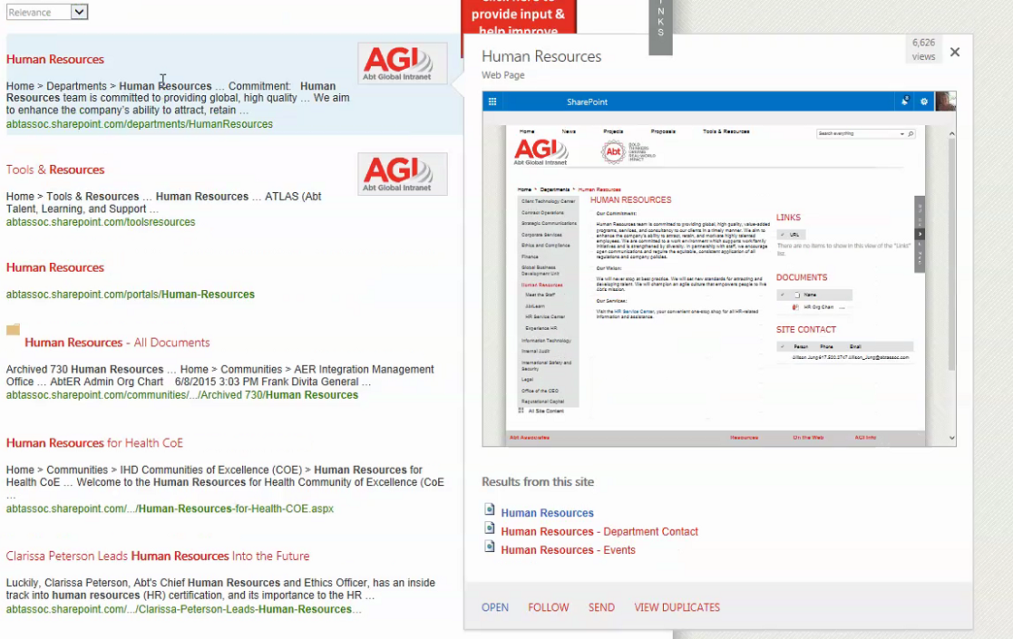
Search result and out of the box sort capabilities
Sort the results by relevance, type, client, most recent(newest to oldest).– Check with Sarah Moody at the time when configuring
This types of preview results are only available when search results are sites/pages, for changing them to our needs e.g. displaying project description will require customization, will need to explore further.
Knowledge Hub Search Results
With hover over details
ESPECIALLY PROJECT DESCIPTIONS
Color coded summaries of results displayed
Project Details
Boilerplates
Notes:
User Comment: Users should be able to look at the project description (hoover screen is an option).
Deepa:
Again to what extent customization can be done with hover is yet to be identified.

Slide 22
Illustration of existing sharepoint hover over – and how large it can be

Slide 23
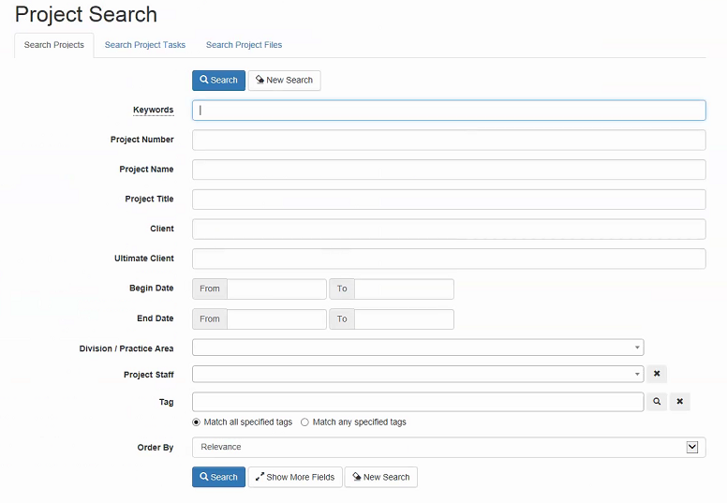
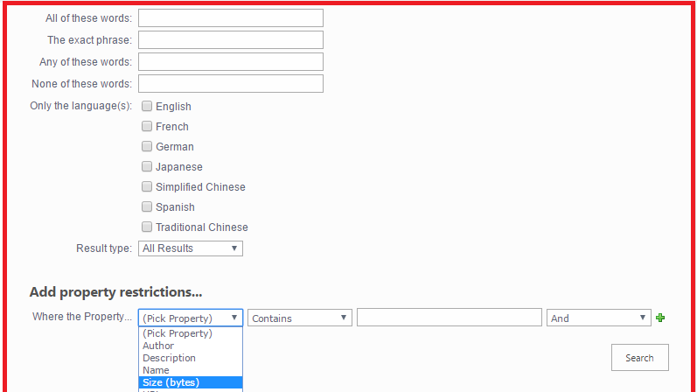
Advance search capablities
Notes:
Deepa:It is to be determined that how frequently advanced search is used.

Slide 24
Appendix

Slide 25
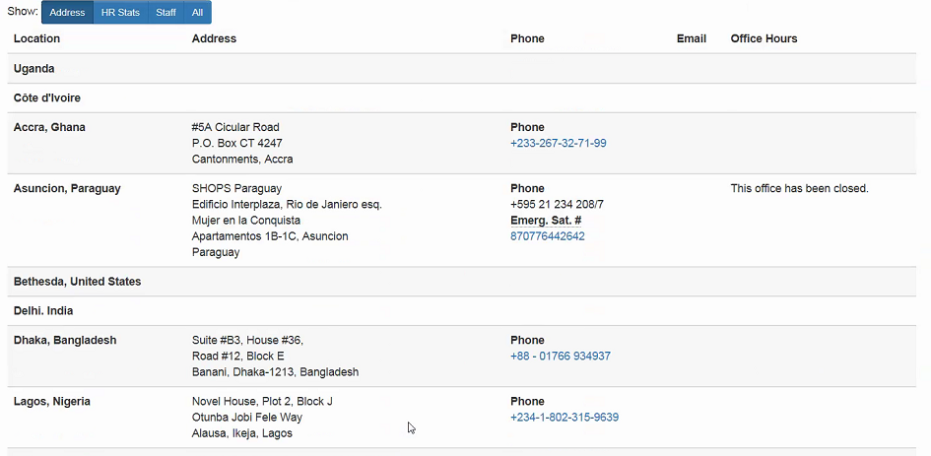
Site Locations- TBD for future in SharePoint
Notes:
This is the site offices specific to the project– that are manually incorporated into abt knowledge

Slide 26
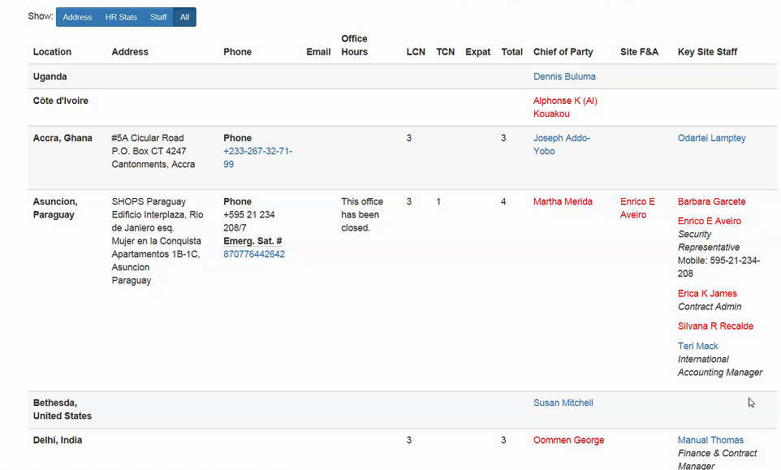
Site locations cont… TBD for future in SharePoint

Slide 27
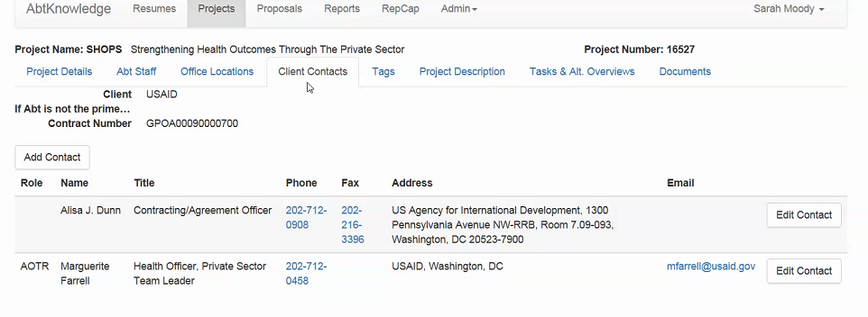
Client Contacts- Manually added in Abt K– TBD for future in sharepoint

Slide 28
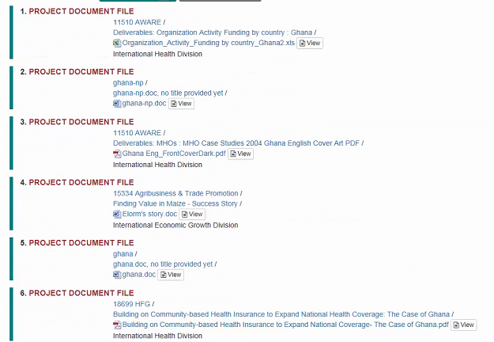
Project Files– will be standard document library with metadata

Slide 29
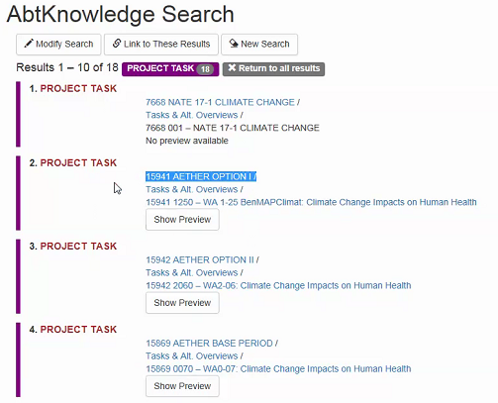
Project Task

Slide 30
Abt K tags

Slide 31
Abt K Project Descriptions

Slide 32
Abt K Project Descriptions Cont…
Notes:
Project description is made up of multiple fields

Slide 33
Task level alt overview

